Slide 1
Pluto – Virtual Mouse and Voice Assistant
Department of Information Technology
BE Major Project
Semester: VIII
AY 2023-24
Group Members:
Ayush Warang, Akshay Godhale, Vedant Kajrekar
Under the guidance of: Prof. Rohit Barve

Slide 2
Outline
Abstract
Introduction
Motivation
Objectives
Problem Statement
Literature Survey
Methodology
Results and output
Conclusion and Future Scope
References

Slide 3
Introduction
- Non-verbal communication, particularly through gestures, plays a vital role in human interaction, conveying messages through body movements and hand gestures.
- From simple pointing to complex sign language, gestures enable effective communication, enhancing engagement with others.
- Leveraging hand motions as a means of interaction with computers, we aim to revolutionize human-computer interaction.
- In our project, we explore how hand gestures can replace traditional mouse functions, offering a more intuitive and accessible interface.
- Utilizing low-cost input devices like webcams, we capture hand movements as input, making the technology affordable and widely accessible.
- By modeling predetermined command-based movements, we aim to manipulate materials efficiently, further enhancing the utility of our system. - Non-verbal communication, particularly through gestures, plays a vital role in human interaction, conveying messages through body movements and hand gestures.
- Leveraging hand motions as a means of interaction with computers, we aim to revolutionize human-computer interaction.
- In our project, we explore how hand gestures can replace traditional mouse functions, offering a more intuitive and accessible interface.
- Utilizing low-cost input devices like webcams, we capture hand movements as input, making the technology affordable and widely accessible.
- By modeling predetermined command-based movements, we aim to manipulate materials efficiently, further enhancing the utility of our system.

Slide 4

Problem Statement
- Traditional computer input methods like mice and keyboards may pose limitations for users with physical disabilities or those requiring enhanced accessibility.
- These methods might not fully exploit the potential for intuitive human-computer interaction.
- The main challenge is to develop a reliable and efficient system allowing users to control their computer cursor and perform diverse tasks using hand gestures and voice commands.
- The goal is to enhance accessibility, naturalness, and user-friendliness in computing.

Slide 5
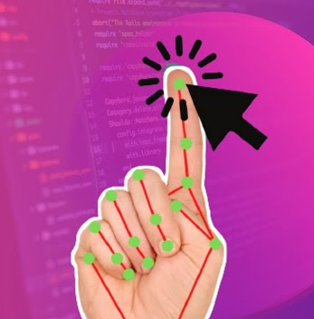
Motivation
The "Virtual Mouse and Voice Assistant" project aims to enhance human-computer interaction, making it more intuitive and accessible.
Our goal is to enable users to control computers using familiar hand gestures and natural spoken language.
The project adopts a cost-effective approach, utilizing standard webcams and software to ensure affordability and accessibility.
Cutting-edge technologies such as MediaPipe, OpenCV, and machine learning are explored to create an efficient and enjoyable computing experience.
Ultimately, the project strives to bridge the gap between humans and computers, making interaction seamless and empowering for all users.

Slide 6
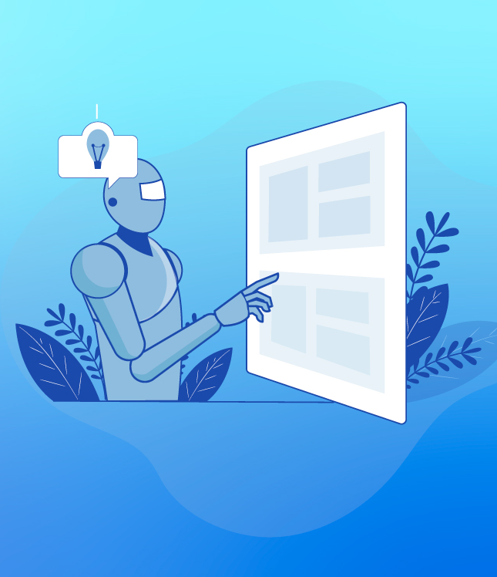
Objectives
Gesture-Based Cursor Control
Diverse Gesture Actions
Voice Assistant Integration
Machine Learning and Computer Vision
Cost-Effective Accessibility
User-Friendly Interface

Slide 7
Literature Survey
Early methods for AI-driven virtual mouse systems involved glove-based approaches for data collection, followed by colored paper attachments for gesture recognition.
Glove-based methods faced challenges such as impracticality, potential allergies, discomfort during prolonged use, and inconsistent accuracy in mouse operations.
Recent advancements leverage Google's mediapipe framework, enabling gesture-controlled virtual mouse systems that offer functions like left click, right click, drag and drop, volume control, and brightness adjustment through hand gestures.
Efforts have also been directed towards camera-based hand gesture recognition interfaces, expanding the range of possibilities for intuitive interaction with virtual environments.

Slide 8
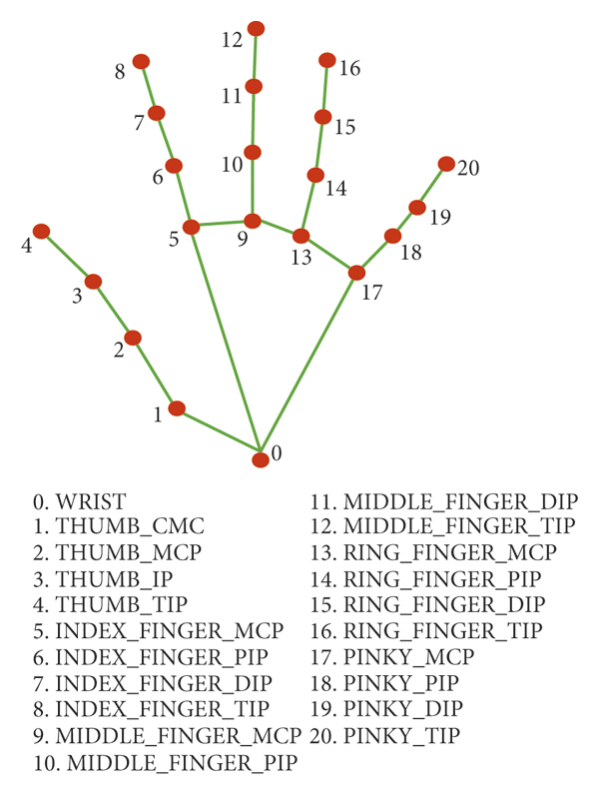
Methodology
The virtual mouse system utilizes camera image data from a personal computer or laptop, with the webcam capturing frames sent to an AI system.
Camera image data from a computer or laptop's webcam is utilized by the virtual mouse system, which then processes frames through an artificial intelligence system.
Steps include :
Video Stream for Hand
Hand Detection
Hand Gesture
Controlling Pointer Position
Controlling Mouse Functions with Gestures

Slide 9
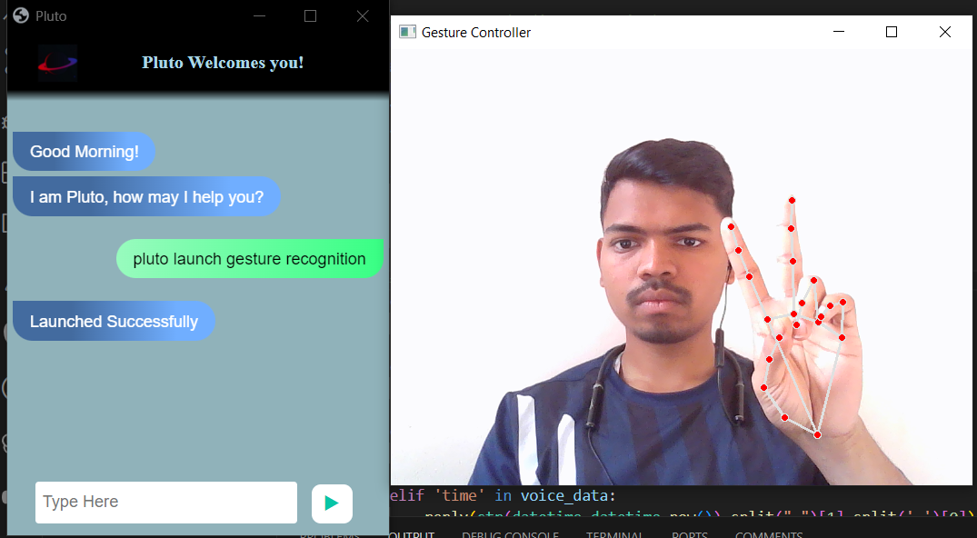
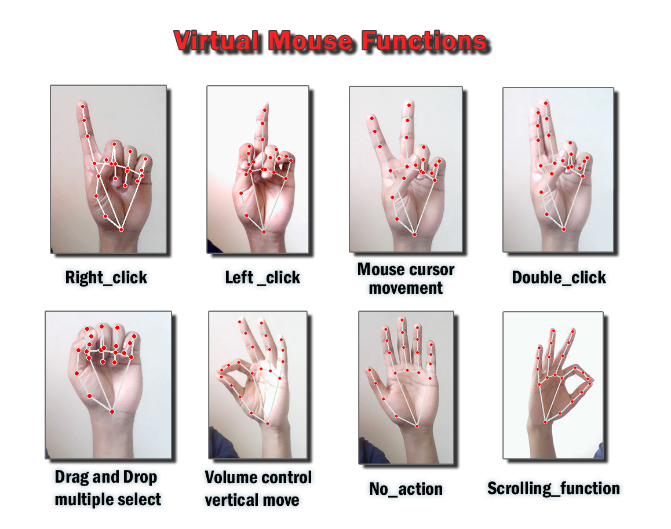
Results
"Virtual Mouse and Voice Assistant" project enhances human-computer interaction through gesture recognition and voice command processing.
Testing and user evaluations revealed notable accomplishments and insights for future improvements.
Gesture Recognition:
Users found the system intuitive and efficient for tasks like left-click, right-click, and item selection.
Voice Assistant Effectiveness:
Successfully interpreted voice commands and executed corresponding actions.
Users were satisfied with its performance in launching and stopping gesture recognition, conducting web searches, and managing file navigation.
These results underscore the project's success in advancing human-computer interaction through intuitive controls and effective voice assistance.

Slide 10

Conclusion and Future Scope
Conclusion:
Hand gesture recognition and voice assistant systems play a crucial role in enhancing human-machine interaction.
Implementation using hand gesture recognition holds significant promise across the technology industry.
MediaPipe, a machine learning-based framework, proves effective in developing applications for hand gesture recognition.
It contributes to creating efficient and advanced human-computer interaction solutions.
Future Scope:
The future of virtual gesture control and voice assistance is bright. Research continues to improve accuracy, expand gesture recognition capabilities, and enhance natural language understanding.

Slide 11
References
https://www.topcoder.com/thrive/articles/what-is-the-opencv-library-and-why-do-we-need-to-know-about-it
https://github.com/nicknochnack/MediaPipeHandPose/blob/main/Handpose%20Tutorial.ipynb
https://learnopencv.com/introduction-to-mediapipe/
https://ijirt.org/master/publishedpaper/IJIRT152099_PAPER.pdf

